Slide 1
Data Transformation
Session 5
Dan Herman
December 13, 2020
Notes:
In this session we'll begin to tackle one of the fundamental issues in data analysis and that is the process of transforming, or wrangling, your data set.
Note, content here is adapted from presentation created by Amrom Obstfeld

Slide 2

Presentation adapted from… Amrom Obstfeld
Assistant Professor of Clinical Pathology and Laboratory Medicine
University of Pennsylvania Perelman School of Medicine
Director of Hematology and Coagulation Laboratories
Children's Hospital of Philadelphia
Notes:
Amrom Obstfeld MD, PhD, is the Medical Director of the Division of Pathology Informatics as well as the Hematology Laboratory at Children’s Hospital of Philadelphia. After receiving his MD and PhD degrees from the College of Physicians and Surgeons at Columbia University, he went on to train in Clinical Pathology at the Hospital of the University of Pennsylvania. In addition to his duties within the Hematology Laboratory, Dr. Obstfeld’s clinical responsibilities include leading the development of analytic tools to aid in laboratory quality management, administration, and operation, and interfacing with other groups throughout the hospital on informatics initiatives.. His research focuses on utilizing clinical and pre-clinical laboratory data sets for predicting diagnosis and prognosis using statistical and machine learning techniques. Dr. Obstfeld plays a major role in designing and implementing educational experiences for pathology trainees and faculty at the University of Pennsylvania within the areas of clinical and pathology informatics.

Slide 3
Goal
Learn how to use dplyr to transform data frames
Appreciate the role of piping in facilitating data transformation
Objectives
Use the pipe operator to pass the output of one function as an input to the next function
Create new calculated columns not found in the original data frame

Slide 4

%>%
Notes:
Now that we have a decent toolkit of functions with which to manipulate our data we should take a step back and talk about the data analysis process.
In any real data manipulation task you're probably not just going to use one verb but you're going to string multiple verbs together into a series of steps that overall accomplish a goal.

Slide 5

Data Analysis Steps
day_10 <- filter(covid_testing, pan_day <= 10)
Which patient locations sent COVID testing in the first 10 days of the pandemic?
day_10 <- select(day_10, clinic_name)
day_10 <- arrange(day_10, clinic_name)
1. Filter tests to those from pandemic day 10 or earlier
2. Select the column that contains the ordering location
3. Arrange those columns by location
Notes:
For instance, in the context of the covid_testing data set, we might be interested in which clinical areas were the first to begin ordering our COVID test.
To accomplish this we're going to need to first filter to the rows that contain orders from the first 10 days of the pandemic. Then we'll select the column that contains the ordering location, and finally we'll arrange that column so that it's sorted by location.
→
Using the methodology we've learned so far this is how we would likely get this task done. We would first filter our original dataset specifying that we want pan_day, which contains the pandemic day of the order, to be less than or equal to 10. We'll assign that to a new object called day_10.
then we would select one column, the clinic_name column, from that dataset, we can overwrite and assign that back to day_10.
Finally we'll probably want to arrange that data set by the clinic_name column so we can get a more organized picture of the ordering locations.
Now if I put on my editorial hat I'd say that this is organized code, but it's not very efficient. We've written day_10 5 times here. We're creating the day_10 object and then overwriting it again and again. So is there a better way?

Slide 6
Data Analysis Steps
day_10 <- arrange(
select(
filter(
covid_testing,
pan_day <= 10
),
clinic_name
),
clinic_name
)
Notes:
There is this way.
Here we are nesting these functions one within the other. When nesting functions the innermost function is evaluated first followed sequentially by the next inner ones.
We can see that we have made the code much more efficient but at a significant price. The code is really complicated to look at, it’s not at all obvious what the code is trying to accomplish. The arguments for functions are spatially far away from the names of the functions themselves.
What would be helpful when performing data analyses such as these would be a syntax that was both efficient as well as human readable.

Slide 7
The Pipe Operator %>%
Passes result on left into first argument of function on right.
covid_testing
%>%
filter(____, pan_day <= 10)
filter(covid_testing, pan_day <= 10)
covid_testing %>% filter(pan_day <= 10)
Notes:
This is exactly what the pipe operator does.
The pipe operator is this percent, greater than, percent symbol. It's a tool that we use to glue the pieces of our analysis together into one pipeline.
The pipe operator does something very simple but at the same time incredible useful. It takes the product of whatever is on the left and puts it into the function on the right.
So for example, the two lines of code in the gray box do exactly the same thing.
There are a whole bunch of reasons as to why this is a useful thing but for me, one of the most important reasons is that it turns computer code into something that is almost legible as human language.
You could essentially read the second line of code as “Take the covid_testing data frame, and then filter the pan_day column to rows that are less than or equal to 10.”

Slide 8
Data Analysis Steps
day_10 <- arrange(
select(
filter(
covid_testing,
pan_day <= 10
),
clinic_name
),
clinic_name
)
Notes:
The advantage of this is even more clear when performing a more complicated analysis such as this one. You can take this code, which is essentially illegible, and transform it into the code on the following slide.

Slide 9
Data Analysis Steps
covid_testing %>%
filter(pan_day <= 10) %>%
select(clinic_name) %>%
arrange(clinic_name)
Notes:
The code here is far more succinct. It's essentially self describing since it’s written in a sequential, essentially human readable format.
The pipe operator allows us to form chains that accomplish complicated data transformation operations but which are made up of very simple, self-contained, building blocks. So we're able to make something complex by joining together many simple elements that are easy to understand in isolation.
An additional benefit is that it makes it easier to actually write code because it's much easier to translate our thoughts into an analytical pipeline.

Slide 10

Example: TAT investigation
The PICU would like a word with you because of a recent incident involving a delay in results for a patient who required an aerosol generating procedure.
They had to wait over 10 hours before the procedure could begin!
You decide to investigate…WITH DATA
Notes:
OK so let's put this to action. Imagine you get a call from the medical director of the PICU. She wants to know what's going on in your lab! She had to wait 10 hours for a COVID test result, meanwhile there was a patient who was awaiting an aerosol generating procedure!
You decide to investigate using the covid_testing data set

Slide 11

Your Turn 1
Open ‘05– Transform.Rmd’ and run the setup chunk.
Use %>% to write a sequence of three functions that:
1. Filters to orders from the clinic (clinic_name) of "picu”
2. Selects the columns with the receive to verify turnaround time (rec_ver_tat) and day from start of the pandemic (pan_day)
3. Arrange the `pan_day` from highest to lowest
4. Use <- to assign the result to a new variable and take a look.
Notes:
8 minutes

Slide 12
Isolating data
Extract variables with select()
Extract rows with filter()
Arrange rows, with arrange().
Notes:
So far we’ve covered functions whose primary job is to reshape your data but don’t fundamentally tell you something about what’s inside of it.

Slide 13
Deriving Data
Notes:
Until now we've

Slide 14

What are the average and standard deviation of the total turnaround time for each ordering clinic?
Notes:
If you’re interested in orders for basic metabolic panels from September, then you can do that. However if you want to learn something from your data you have to summarize it. For instance, what if you want to know what your lab’s top three ordered tests are on weekends? You have the right data to answer that question, but we need to derive the answer from it.

Slide 15
Breaking down the analytical question
Total TAT for each order
Group orders by clinic
Calculate average and standard deviation for each clinic
Notes:
To answer a question like the one we posed on the previous slide, it can help to break it down into the steps that we need to take to get to the finish line. In this case, we’re going to have to figure out which weekday the tests were ordered. We’ll probably be working with the order_time column for that. Then we’ll have to count the number of orders per test on the weekend. Finally we’ll have to put the in rank order.

Slide 16
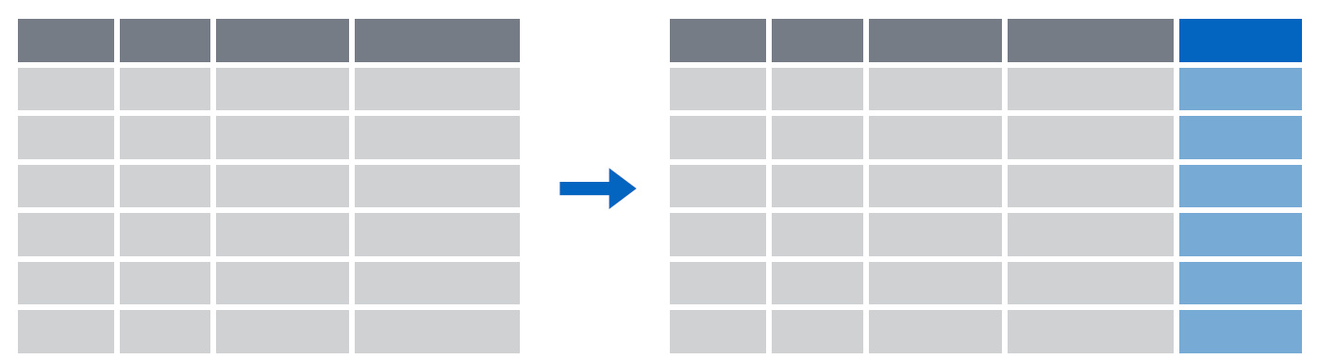
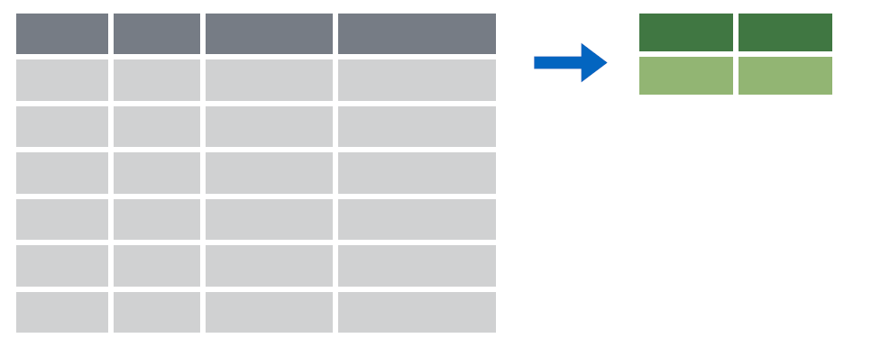
Deriving data
Make new variables with mutate()
Make summaries of data with summarize()
Notes:
To answer questions like these we’re going to need a new set of functions whose job is to derive new data from our original data frame. The two work-horse functions in dplyr to accomplish these types of tasks are mutate() and summarize().

Slide 17
mutate()
Notes:
We’ll begin with the mutate() function.

Slide 18
mutate()
Creating new calculated columns
= Number of rows
↑ Number of Columns
Notes:
The goal of mutate() is very simple. You’ll feed it your original data frame and it’s going to kick out the same data frame with one or more new columns tacked onto the end based on calculations that you specify.

Slide 19
mutate()
Creating new calculated columns
covid_testing %>%
mutate(new_column = calculation)
function whose results will populate columns
name for
new column
equals
Notes:
The syntax is going to look familiar to the functions we saw earlier but with a small change. As before, the first argument is the original data frame, which gets piped into mutate. Then you specify the name of the new column you want to add, you type of an equals sign, and then you write a calculation. This calculation will be run on each row of your data frame and the result will populate each row of the new column.

Slide 20
mutate()
calculation can involve another column in the data frame
Creating new calculated columns
covid_testing %>%
mutate(c_r_tat_mins = col_rec_tat * 60)
mrn | col_rec_tat | rec_ver_tat
5000876 | 29.5 | 11.5
5006017 | 3.6 | 5
5001412 | 1.4 | 5.2
5000533 | 2.3 | 5.8
mrn | col_rec_tat | rec_ver_tat | c_r_tat_mins
5000876 | 29.5 | 11.5 | 1770
5006017 | 3.6 | 5 | 216
5001412 | 1.4 | 5.2 | 84
5000533 | 2.3 | 5.8 | 138
Notes:
Let’s look at an example. Let’s calculate TAT in minutes instead of hours.

Slide 21
Your Turn 2
Create a new column using the mutate() function that contains the total TAT (sum of col_rec_tat and rec_ver_tat)
Notes:
3 mins

Slide 22
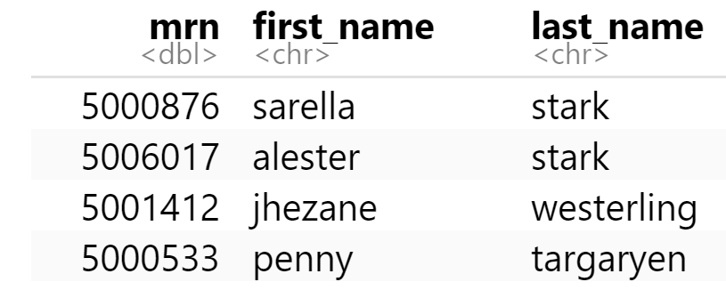
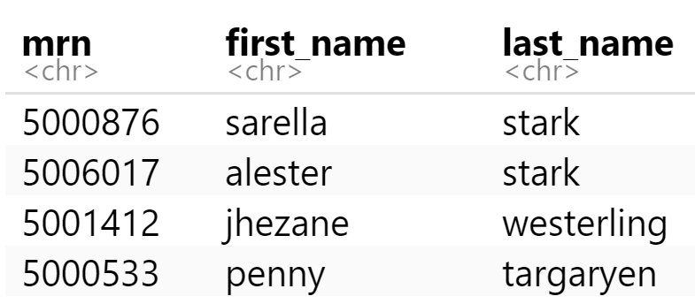
mutate()
Function to "coerce" one date type into another data type
Replace columns
orders %>%
mutate(mrn = as.character(mrn))

Slide 23
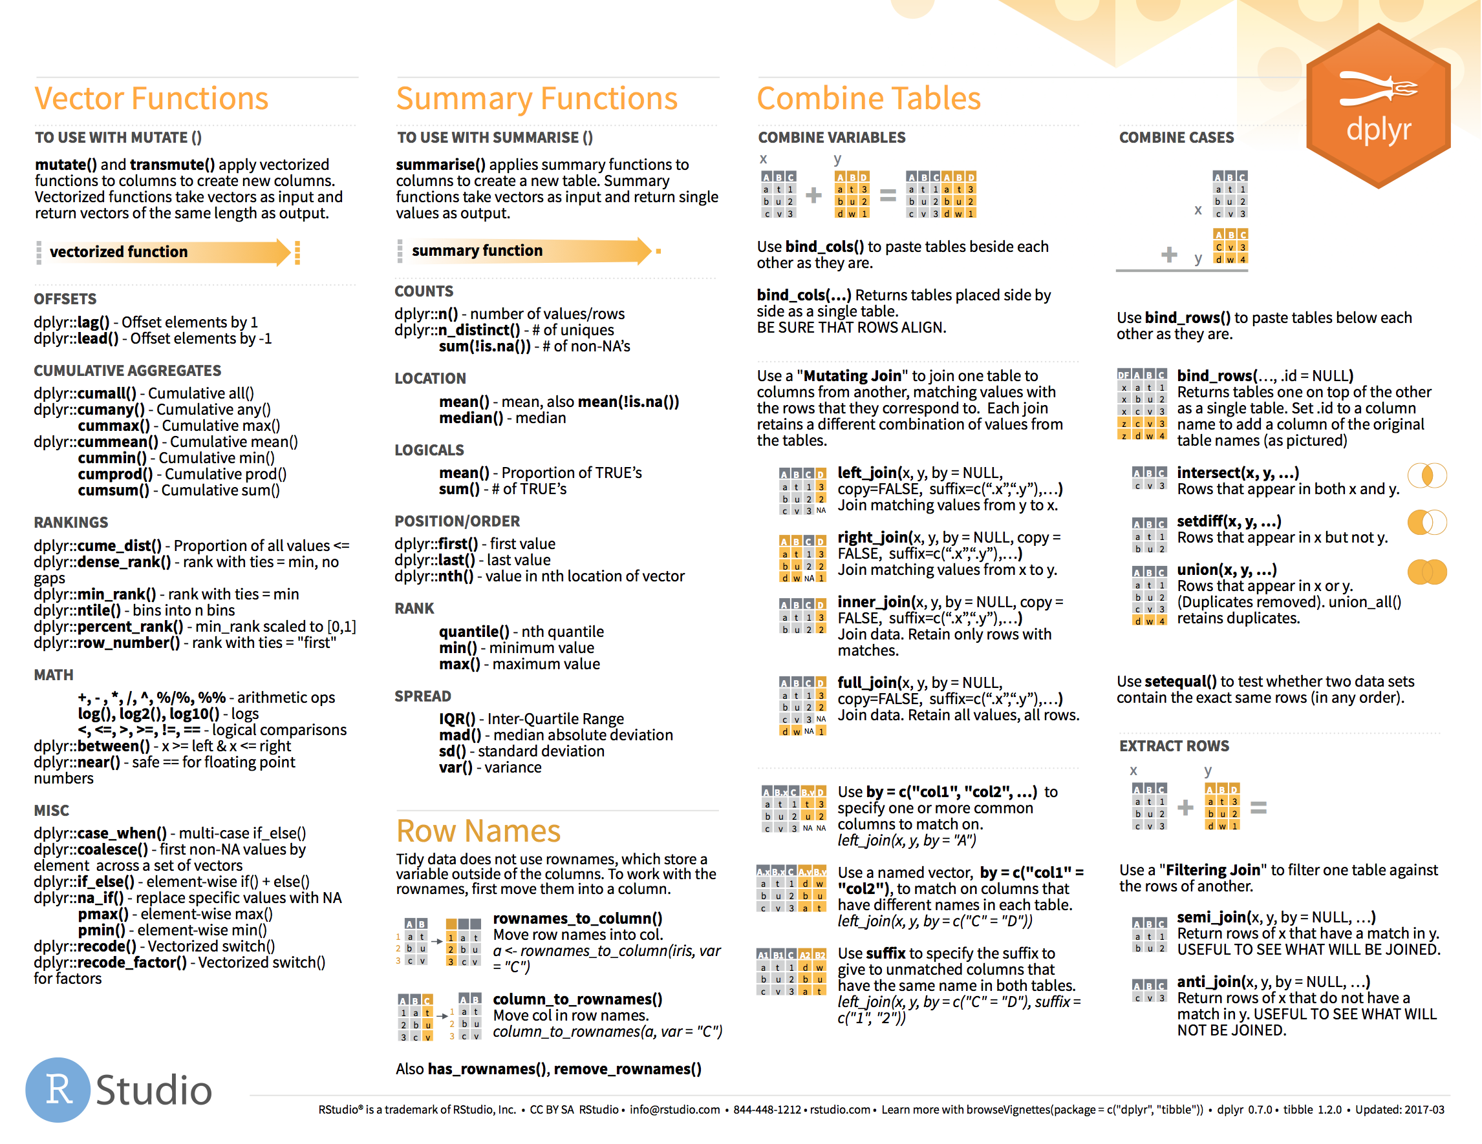
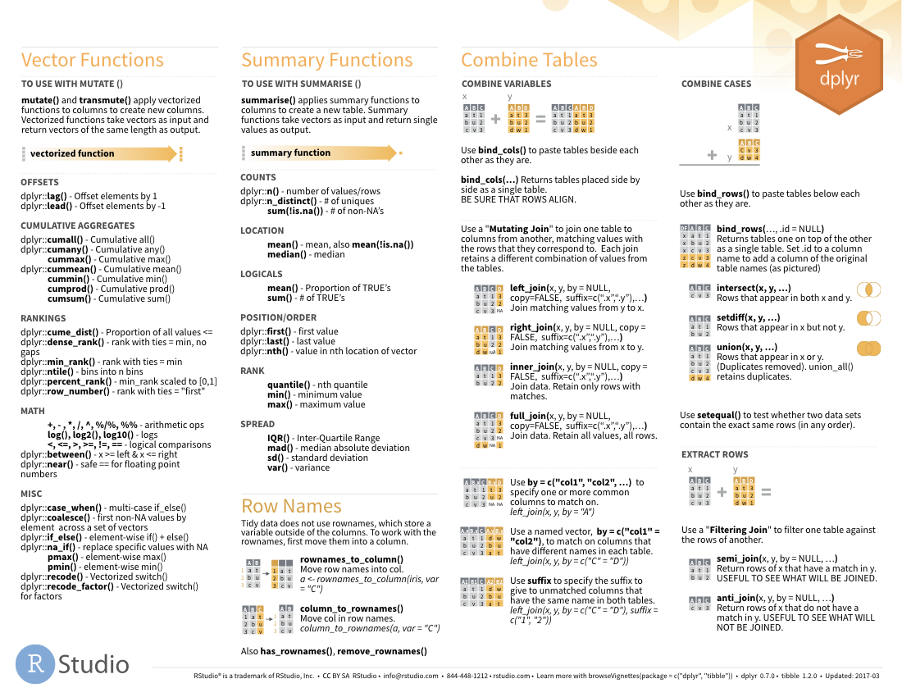

Functions to use in mutate()
on back

Slide 24
Goal
Learn how to use dplyr to transform data frames
Appreciate the role of piping in facilitating data transformation
Objectives
Use the pipe operator to pass the output of one function as an input to the next function
Create new calculated columns not found in the original data frame

